Slide 1
Circuit Design
San San Goh

Slide 2
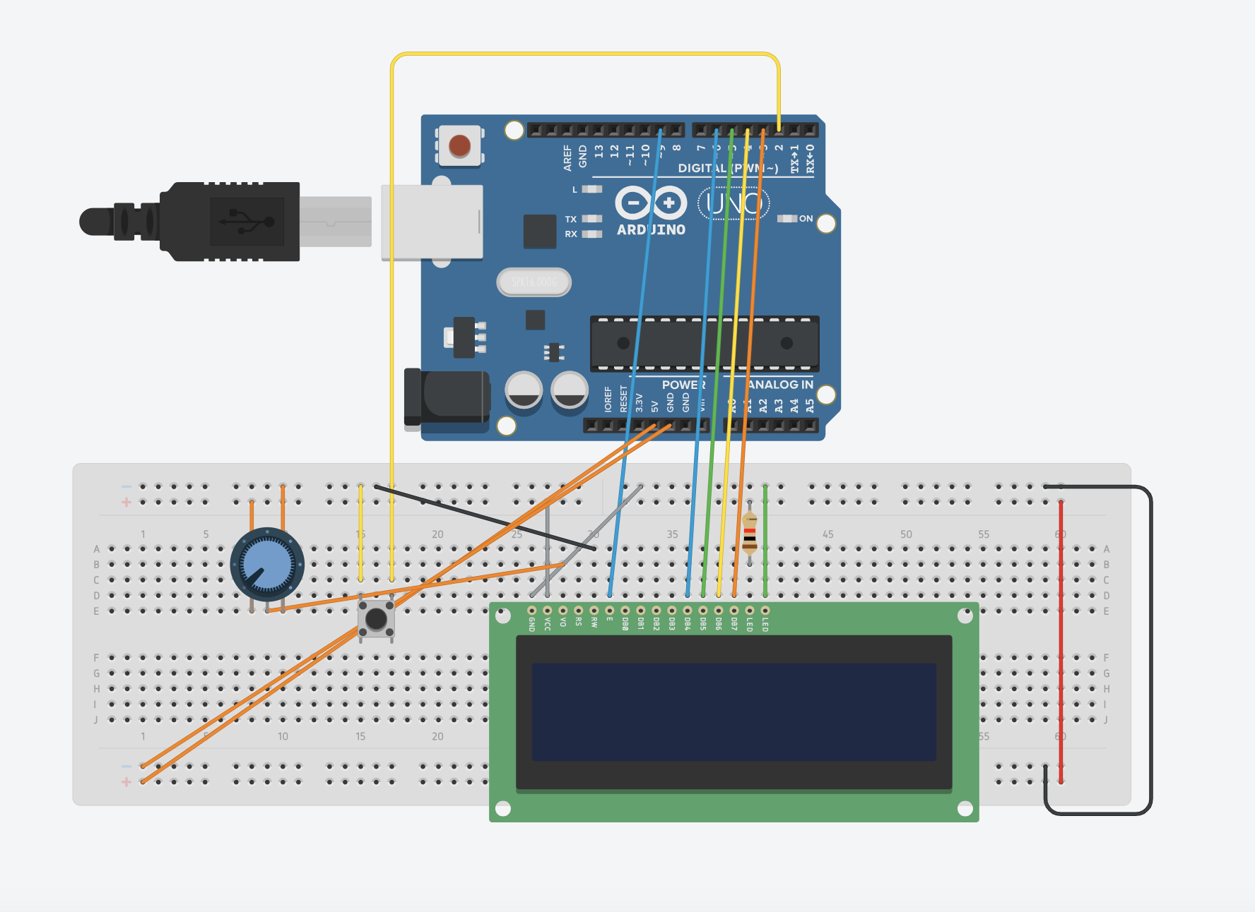
Major Components and Circuit Design
Major components, actuators, sensors:
Pushbutton
Potentiometer
LCD display
Arduino mega
Breadboard

Slide 3
Sensors
Pushbutton
acts as an input device that send digital signal to the arduino when pressed
One of the leg is connected to the arduino digital pin to detect when it is being pressed and the other leg is connected to GND to ensure that the signal is low when not in use and high when it is being pressed
When it is pressed, it triggers the arduino code such as updating the LCD
Potentiometer
Acts as an input device that sends analog to adjust the LCD contrast
The two outer pins is connected to the GND and 5V
The middle pin is connected to V0 pin of the LCD to adjust the contrast

Slide 4
Actuator
LCD display
Acts as an output device that display information based on the signal sent from the arduino
The VSS is connected to GND and VDD is connected to 5V for power
The RS pin is connected to the digital pin so that the LCD can process the data
The RW pin is connected to GND so that it can remain in the write mode
The E pin is connected to the digital pin so that it can signal the LCD to accept data from the arduino
The data pin is connected to four digital pins to receive 4 bits data from the arduino

Slide 5
Major components
Arduino
Acts as a centralised system processing inputs from the pushbutton and potentiometer and controls the LCD output
It reads the pushbutton state through the digital pin and receives analog voltage from the potentiometer through the LCD contrast pin
It sends control signal to the LCD via digital pins (RS, E and D4-D7)
It distributes 5V to the breadboard for the other components attached to it
Breadboard
Acts as a platform to connect the components together and supply power to them
The positive rail is connected to the arduino 5V pin
The negative rail is connected to the arduino GND pin
The LCD, potentiometer and pushbutton is connected together viia the breadboard

Slide 6
Interactions and Data Flow
The arduino supply a 5V power and GND to the breadboard to power the potentiometer and LCD display
The pushbutton triggers the arduino to perform an action when used
The potentiometer provides a voltage to the LCD to adjust the contrast
The arduino reads the input from the pushbutton and decides which action to take according to the program and controls the LCD by sending data through the digital pins, setting thee display and transfer data
The LCD receives command and data from the arduino , process them and display it on the screen
The backlight and contrast is controlled by the power and potentiometer

